Slide 1
Data Understanding

Slide 2
Data Understanding
Business
Understanding
Data
Understanding
Data
Preparation
Data
Deployment
Modeling
Evaluation

Slide 3
Motivation
Currently, machine learning models cannot be generated automatically.
Building a model requires research. And the better we understand the data, the more effective we can be in modeling it.
In many cases, data understanding will tell us if there is a signal in the data. And the process often produces important business value.

Slide 4
Motivation
It is the most under rated step in machine learning projects.

Slide 5
The objectives of this stage
Make sure that our business understanding is represented in the data
Understand what the data represent
Detect anomalies and outliers
Extract initial insights and patterns

Slide 6
What do we do in this stage
Understand the basic characteristics of each feature:
Feature type: numeric, categorical, ordinal,…
Basic statistics: mean, median, range, variance,…
Basic distribution: symmetry, outliers,…
Identify quality issues with the data: Missing values, Outliers,…
Identify basic dependencies between features
Examining new features (feature engineering)

Slide 7
What do we do in this stage
Understand the basic characteristics of each feature:
Feature type: numeric, categorical, ordinal,…
Basic statistics: mean, median, range, variance,…
Basic distribution: symmetry, outliers,…
Identify quality issues with the data: Missing values, Outliers,…
Identify basic dependencies between features
Examining new features (feature engineering)

Slide 8
Feature description
Exactly understand what each feature represent
Describe the data type of each feature

Slide 9
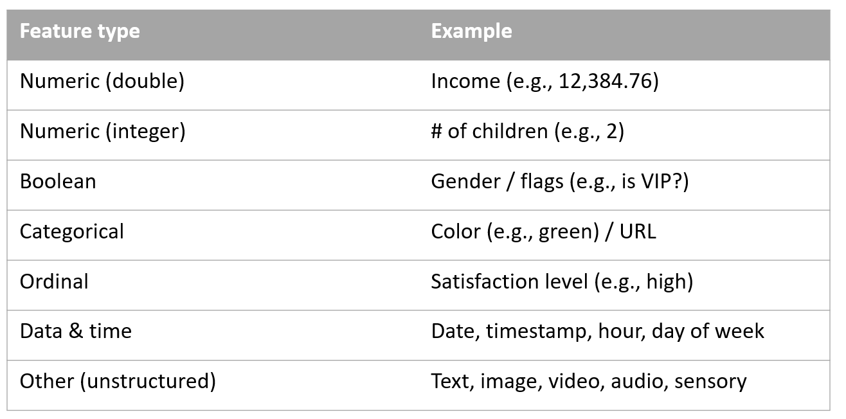
Data Types

Slide 10
Basic descriptive statistics
Mean: quick and easy estimator for the expected value.
Median: more robust than mean. Suitable for skewed and noisy data (e.g., difference between mean income and median income).
Variance / standard deviation: how scattered is the variable around its expected value.
Mode: suitable for nominal values.
Missing values (how many of them?).
More: Percentiles, IQR,…

Slide 11
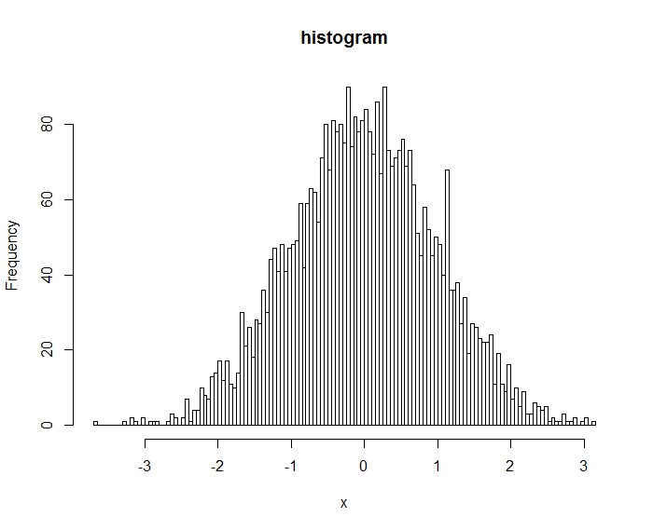
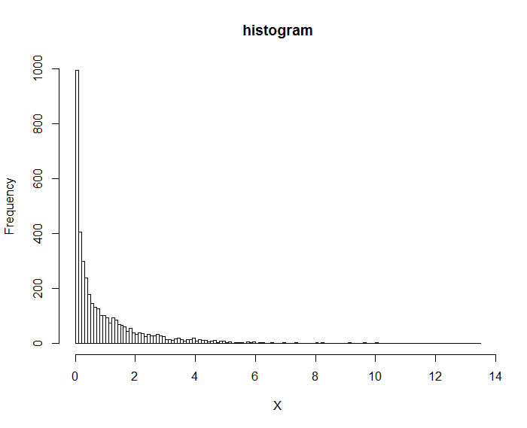
Histogram

Slide 12
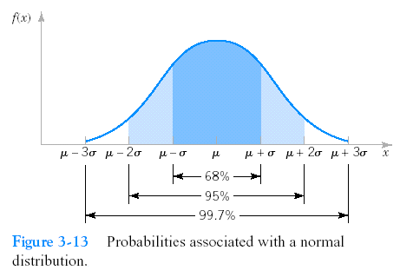
Normal like and log-normal like

Slide 13
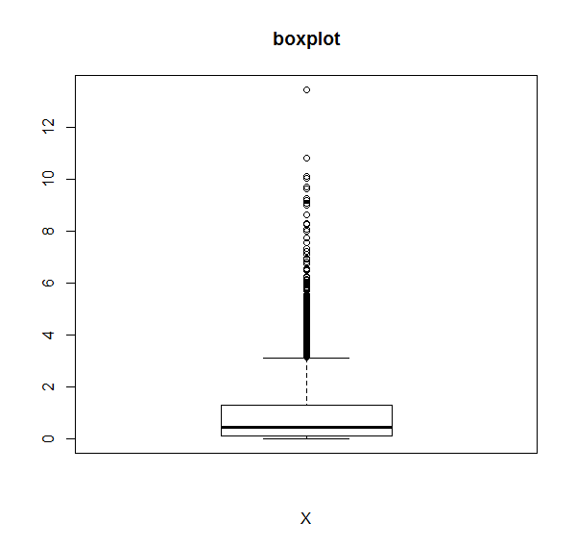
Boxplots

Slide 14
What do we do in this stage
Understand the basic characteristics of each feature:
Feature type: numeric, categorical, ordinal,…
Basic statistics: mean, median, range, variance,…
Basic distribution: symmetry, outliers,…
Identify quality issues with the data: Missing values, Outliers,…
Identify basic dependencies between features
Examining new features (feature engineering)

Slide 15
Missing values
Some of the values in some of the features might be missing:
Total amount of purchases in the last year, for a new customer
Customer didn’t provide non mandatory information

Slide 16
Missing values
Does missing values mean something? Why they are missing?
Per feature: what is the proportion of missing values?
Correlation between missing values in different features – does it mean anything?
How important is the feature with the missing values?
Can the missing values be inferred somehow?

Slide 17
Outliers
Two different cases:
Outliers indicate on errors: we typically delete the suspected value and refer to it as missing.
Outliers indicate on real “long tail”: we typically do not delete the suspected value, but must control its impact while processing it (e.g., through data normalization).
It is sometimes not clear which case are we handling

Slide 18
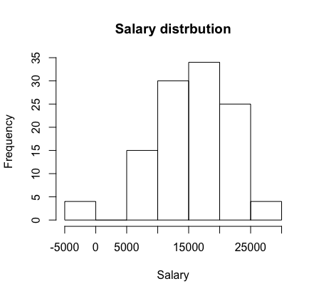
Outliers
Histograms are a good tool for detecting outliers

Slide 19
Outliers
Boxplots are also a good tool (mainly when the distribution is symmetric)

Slide 20
What do we do in this stage
Understand the basic characteristics of each feature:
Feature type: numeric, categorical, ordinal,…
Basic statistics: mean, median, range, variance,…
Basic distribution: symmetry, outliers,…
Identify quality issues with the data: Missing values, Outliers,…
Identify basic dependencies between features
Examining new features (feature engineering)

Slide 21
Dependencies between features
We are interested in relationships between features:
Correlation – Between two numeric features
Mutual Information – Between two discrete (categorical) features.
Ordinal features can be represented as numeric
Numeric features can be discretized (in order to calculate mutual information)
In particular, in classification, we are interested in the correlation (MI) between explaining features and the target.

Slide 22
Pearson’s correlation
There are many form of correlation metrics.
The most common one is Pearson’s correlation.
It measure the linear relation between two numeric variables.
It range between -1 to 1.
It’s not effected from the scale of the variables.

Slide 23
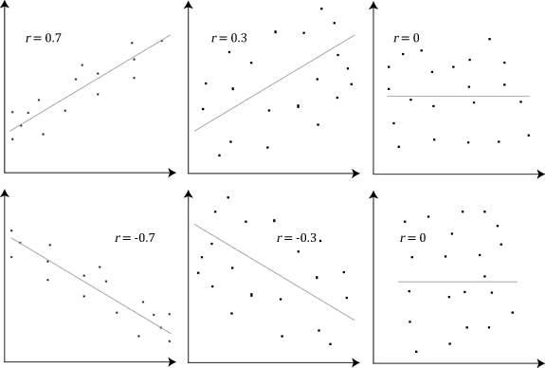
Pearson’s correlation

Slide 24
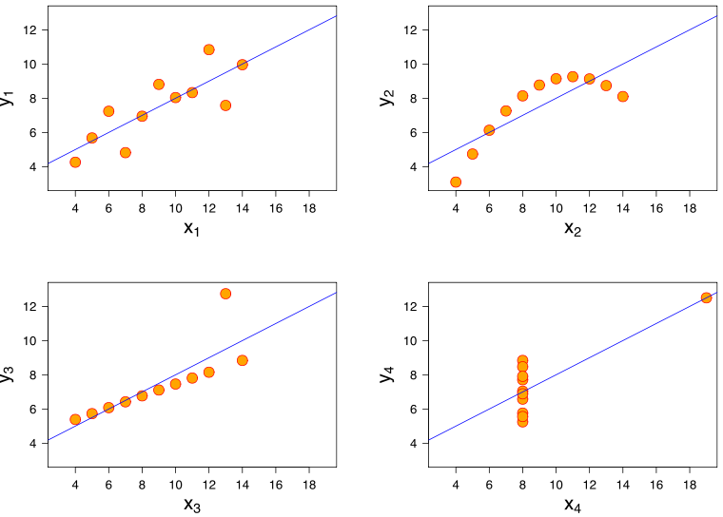
Pearson’s correlation
Pearson’s correlation only measures linear correlation and it has its own limitations

Slide 25
Correlation matrix
A good practice is to observe the correlation matrix of all our numeric features. It’s a very practical tool:
You can make sure, weather the correlation make sense to capture data issues.
You can detect what are the most correlated features to a numeric target variable.
You can detect leakage relative to your label.
Find redundant variables.
You can detect interesting patterns.

Slide 26
Correlation matrix

Slide 27
Mutual information
Mutual information can detect non-linear relationship between two discrete variables.
It measure the reduction in uncertainty (or the "information gained") for feature X_{i} when feature X_{j} is known.

Slide 28
Mutual information
Mutual information can detect non-linear relationship between two discrete variables.
It measure the reduction in uncertainty (measured by “entropy”) for feature X_{i} when feature X_{j} is known.

Slide 29
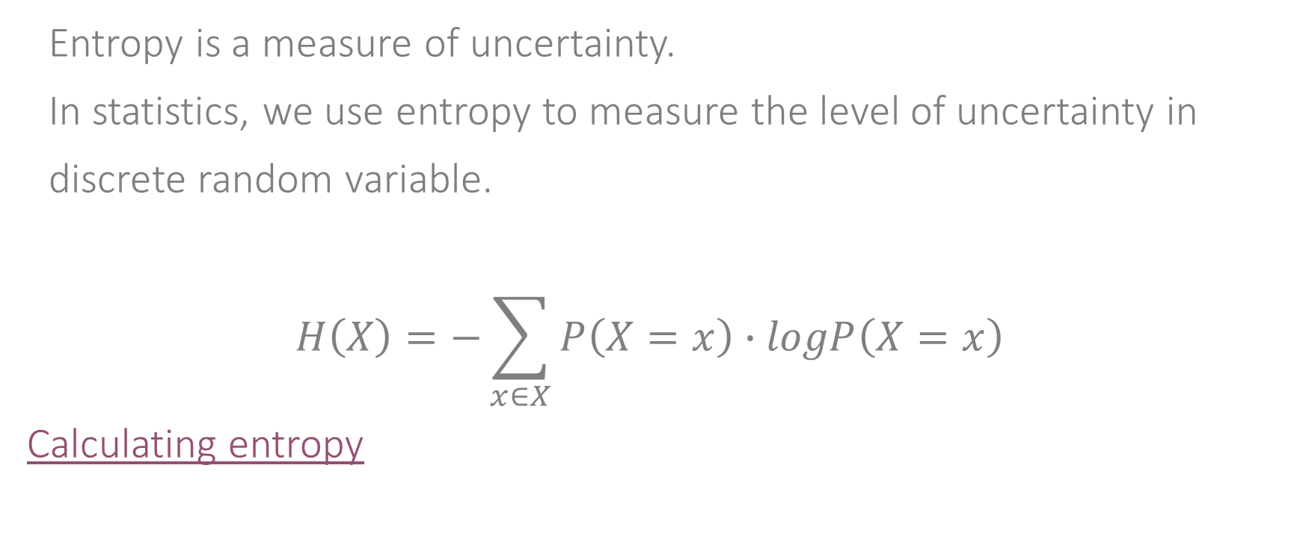
Entropy
Entropy is a measure of uncertainty.
In statistics, we use entropy to measure the level of uncertainty in discrete random variable.
$$H\left(X\right)=−\sum_{x∈X}{P\left(X=x\right)∙logP\left(X=x\right)}$$
Calculating entropy

Slide 30
Mutual information
It measure the reduction in uncertainty (measured by “entropy”) for feature X_{i} when feature X_{j} is known.
I(X_{i};X_{j})=H(X_{i})−H(X_{i} ∣ X_{j})
It can measure non-linear relations
However, the absolute value tells us very little

Slide 31
Correlation is not causality
Correlation (and MI) describe a tendency of the two variables to change together in some way.
It is very tempting to jump into conclusions and infer some causality.
Correlation doesn’t mean causality, but it may be very useful for our prediction or classification tasks.

Slide 32
Correlation is not causality
Correlation (and MI) describe a tendency of the two variables to change together in some way.
It is very tempting to jump into conclusions and infer some causality.
Correlation doesn’t mean causality, but it may be very useful for our prediction or classification tasks.

Slide 33
Correlation is not causality
Examples:
Smoking → cancer; smoking → yellow teeth; does yellow teeth → cancer
Overweight people tend to drink diet drinks. Does diet drinks lead to overweight?

Slide 34
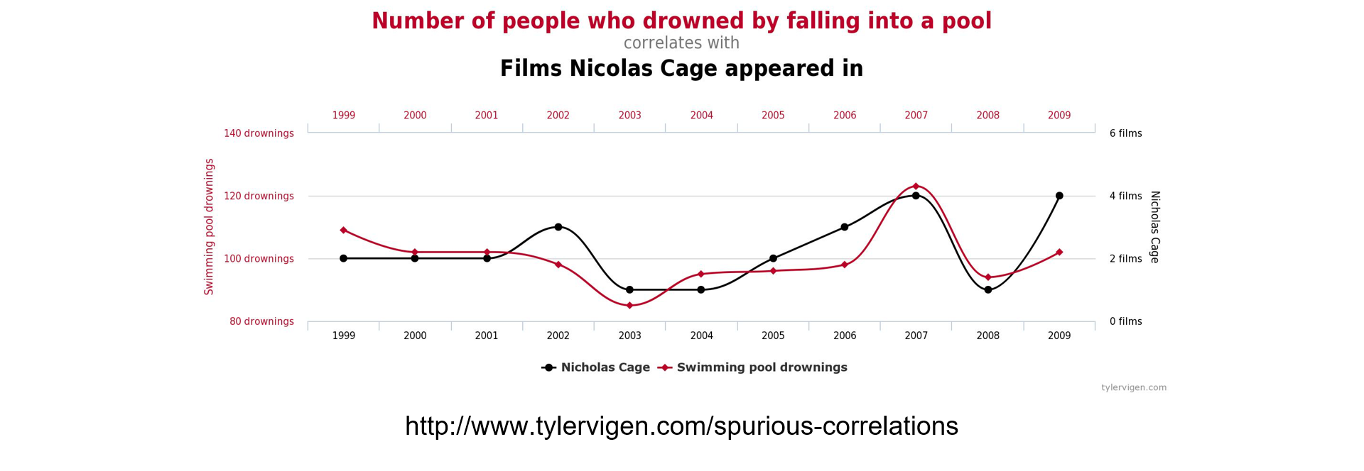
Correlation is not causality
Correlation may even be random

Slide 35
What do we do in this stage
Understand the basic characteristics of each feature:
Feature type: numeric, categorical, ordinal,…
Basic statistics: mean, median, range, variance,…
Basic distribution: symmetry, outliers,…
Identify quality issues with the data: Missing values, Outliers,…
Identify basic dependencies between features
Examining new features (feature engineering)

Slide 36
Feature Engineering
By designing new feature we can make patterns simpler:
Example: what is overweight?
Using height and weight
Using BMI
Designing new features (wisely, of course) can significantly boost up the performance of machine learning algorithms.

Slide 37
Data Understanding

